Slide 1





An Ottawa where all students thrive.
Une ville d’Ottawa où tous les élèves s’épanouissent.

Slide 2
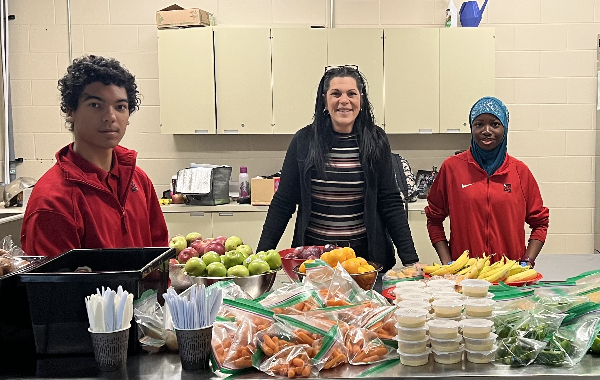


BENEFITS OF THE
SCHOOL BREAKFAST PROGRAM
Students demonstrate improved behaviour, concentration and academic performance
Supports food-insecure students in a stigma free environment
Provides bonding opportunity outside of the classroom
Creates a sense of belonging that can contribute to improved mental health
Provides staff and educators with another meaningful touchpoint with students
Fosters a sense of safety, stability and routine for students
An Ottawa where all students thrive.
Une ville d’Ottawa où tous les élèves s’épanouissent.

Slide 3



PROGRAM OVERVIEW
The School Breakfast Program is funded by the Ottawa Network for Education (ONFE). We receive funding from the Ministry of Children, Community and Social Services (MCCSS), the National School Food Policy, City of Ottawa, corporate partners and individual donors.
Food served must be compliant with the MCCSS Student Nutrition Guidelines.
Learn more at
www.onfe-rope.ca
An Ottawa where all students thrive.
Une ville d’Ottawa où tous les élèves s’épanouissent.

Slide 4
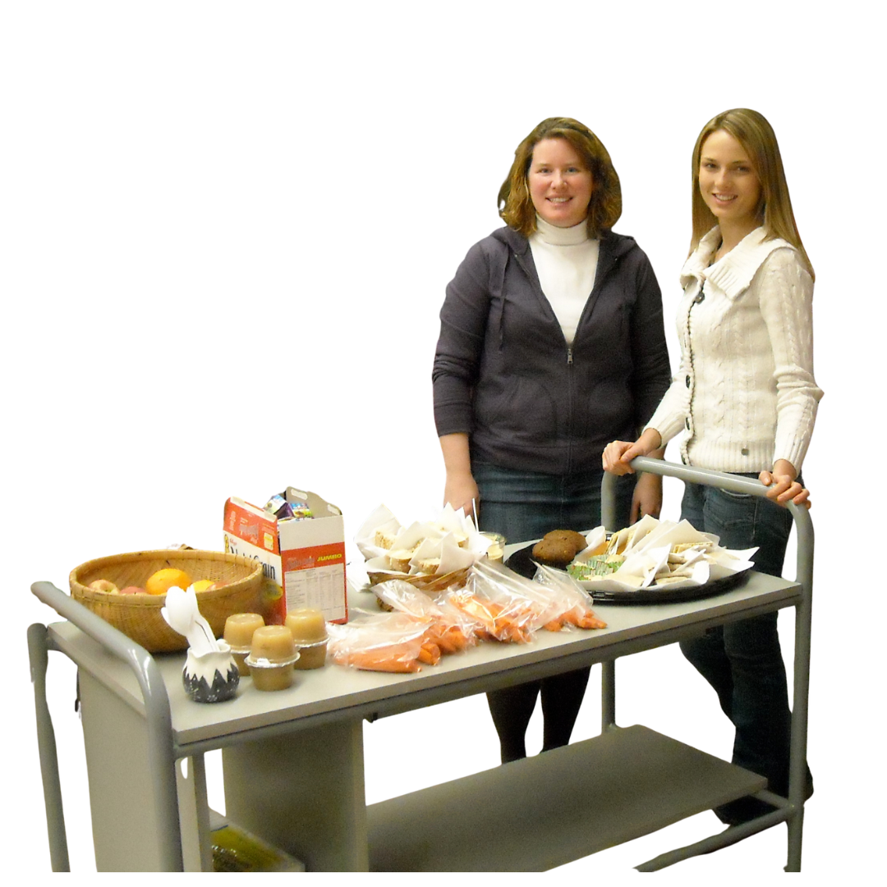
KEY ROLES
Program Coordinator: School staff or community member who looks after the daily operation of our nutrition program.
In-School Team: Staff and volunteers who assist the Program Coordinator with various tasks as needed.
Community Development Coordinator: ONFE staff assigned to our school to ensure smooth
operation of our program.
An Ottawa where all students thrive.
Une ville d’Ottawa où tous les élèves s’épanouissent.

Slide 5
Snack Program
Three Program Types to Choose From
Students take two items
FRUIT or VEG
WHOLE GRAIN or
PROTEIN
Breakfast Program
Students take three items
FRUIT or VEG
WHOLE GRAIN
PROTEIN
Dual Program
All food served must follow the nutrition guidelines as outlined by MCCSS
Students have access to breakfast and snack
BREAKFAST
SNACK
*Whole grain items must list whole grain as the first ingredient, and sugar must be ≤ 8 g per 30g serving.
*Any protein item (including processed cheese, flavoured milk, yogurt etc.) containing more than 11g of sugar per 100g are not permitted.

Slide 6
Flexible Delivery Models
to Suit Needs
BREAKFAST CLUB
SIT-DOWN MEAL SERVED IN ONE LOCATION
GRAB & GO
STUDENTS GRAB THEIR FOOD FROM ONE OR MULTIPLE CENTRAL LOCATION(S)
TIPS & TRICKS
IN-CLASS BINS
BINS OF FOOD ARE DELIVERED TO CLASSROOMS FOR STUDENTS TO USE
*Some schools may choose a hybrid delivery model. For example: a central grab & go station for the older grades but in-class bins for the kinder classes. With in-class bins, it’s important that teachers inform the Program Coordinator if there routinely isn’t enough food.
*For the Grab & Go model, consider separate stations for Grades 7–8 and 9–12 to make access less intimidating for the younger students.
*Create a pleasant eating environment that encourages conversation and limits distractions. Ideally allow 20 minutes to eat, if possible.

Slide 7


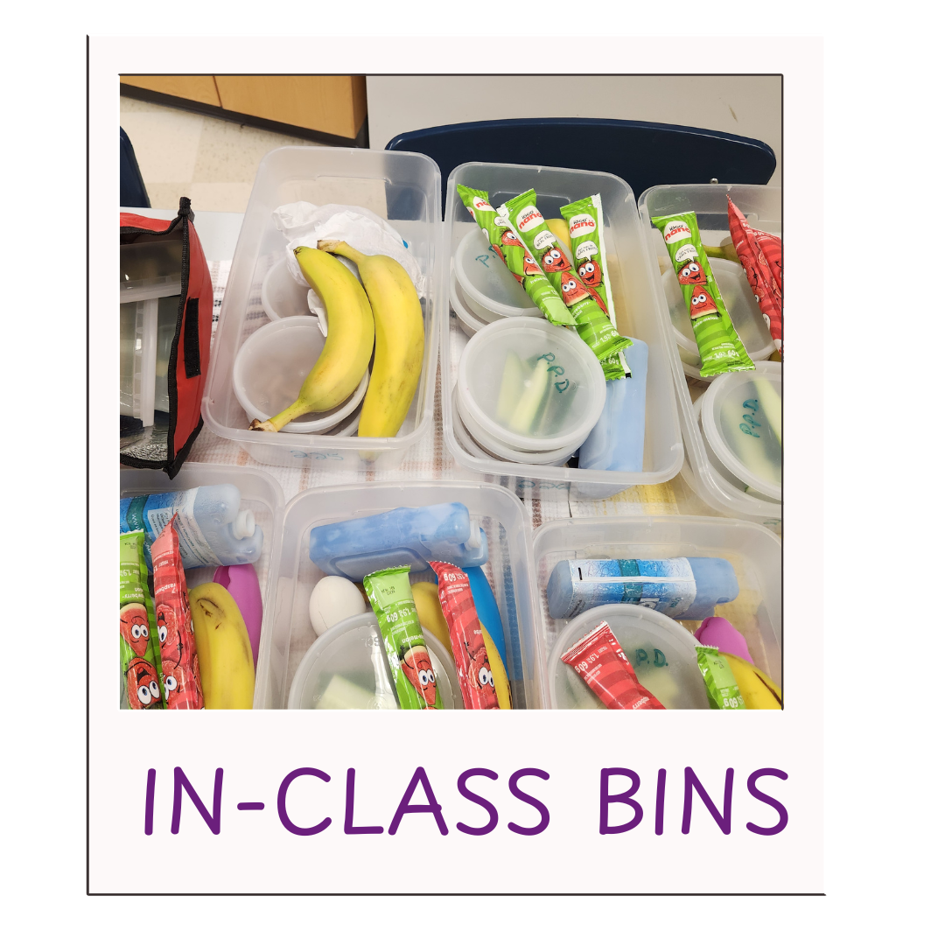
OUR PROGRAM DETAILS
Location:
[add in]
Hours:
[start and end time]
Program Coordinator:
[add name]
Program Type:
[Select: Breakfast / Snack / Meal]
Delivery Model:
[Select: Breakfast Club (Sit-Down / Grab & Go / In-Class Bins]
An Ottawa where all students thrive.
Une ville d’Ottawa où tous les élèves s’épanouissent.

Slide 8
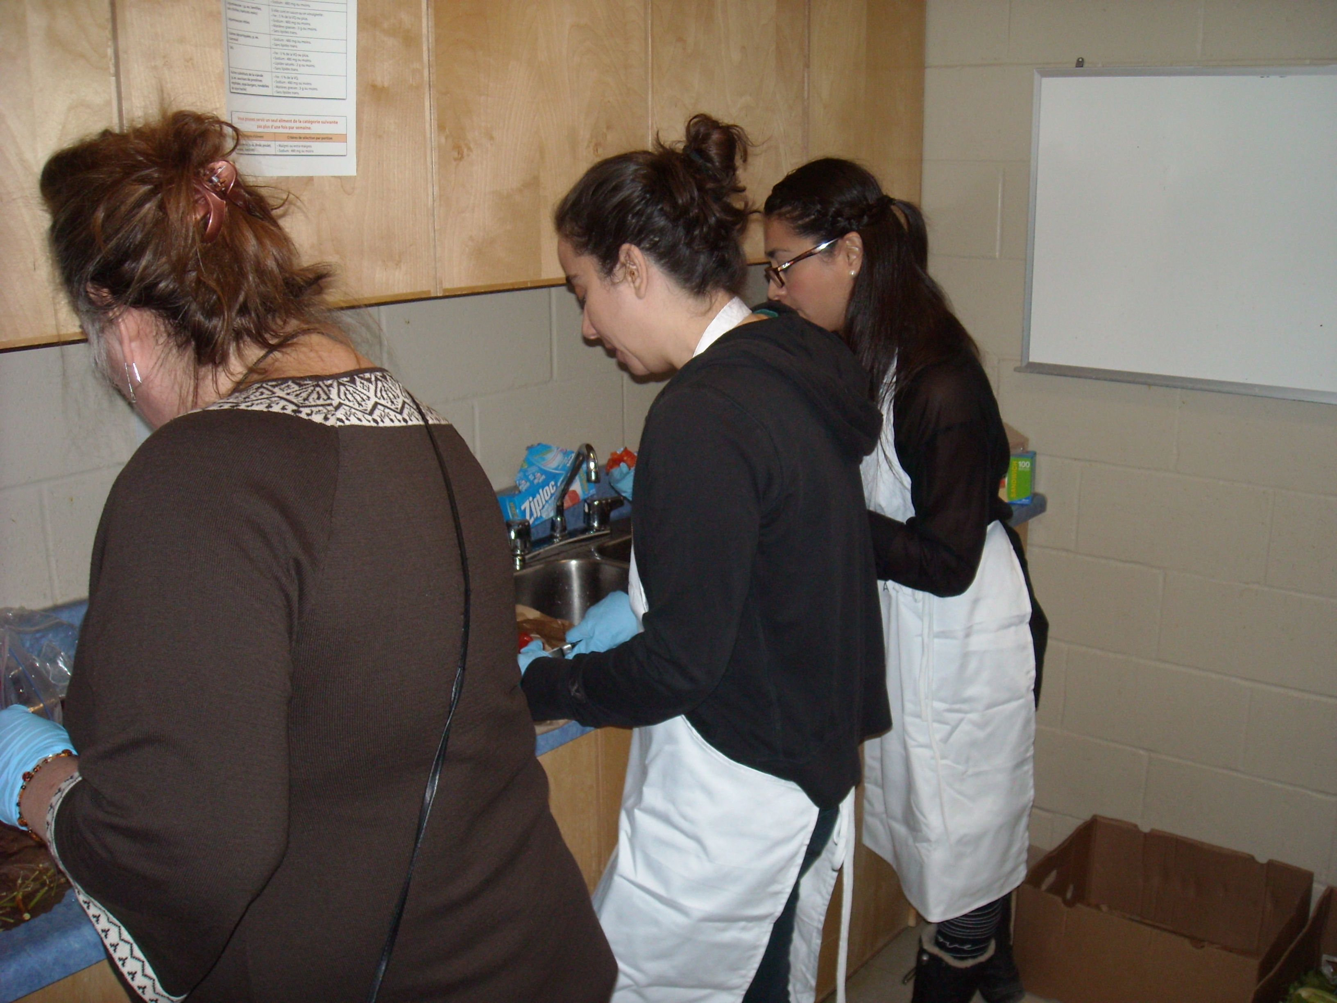
TOGETHER, WE CAN HELP OUR STUDENTS THRIVE
Direct Support
Supervise students during program hours
Assist with food preparation and clean-up
Help create a welcoming, positive eating environment’
Mentor student volunteers
Indirect Support
Inform your students that they have access to this program
Monitor food needs and communicate them to the Program Coordinator
Encourage students to volunteer with the program
Share program information with parents and caregivers
An Ottawa where all students thrive.
Une ville d’Ottawa où tous les élèves s’épanouissent.

Slide 9
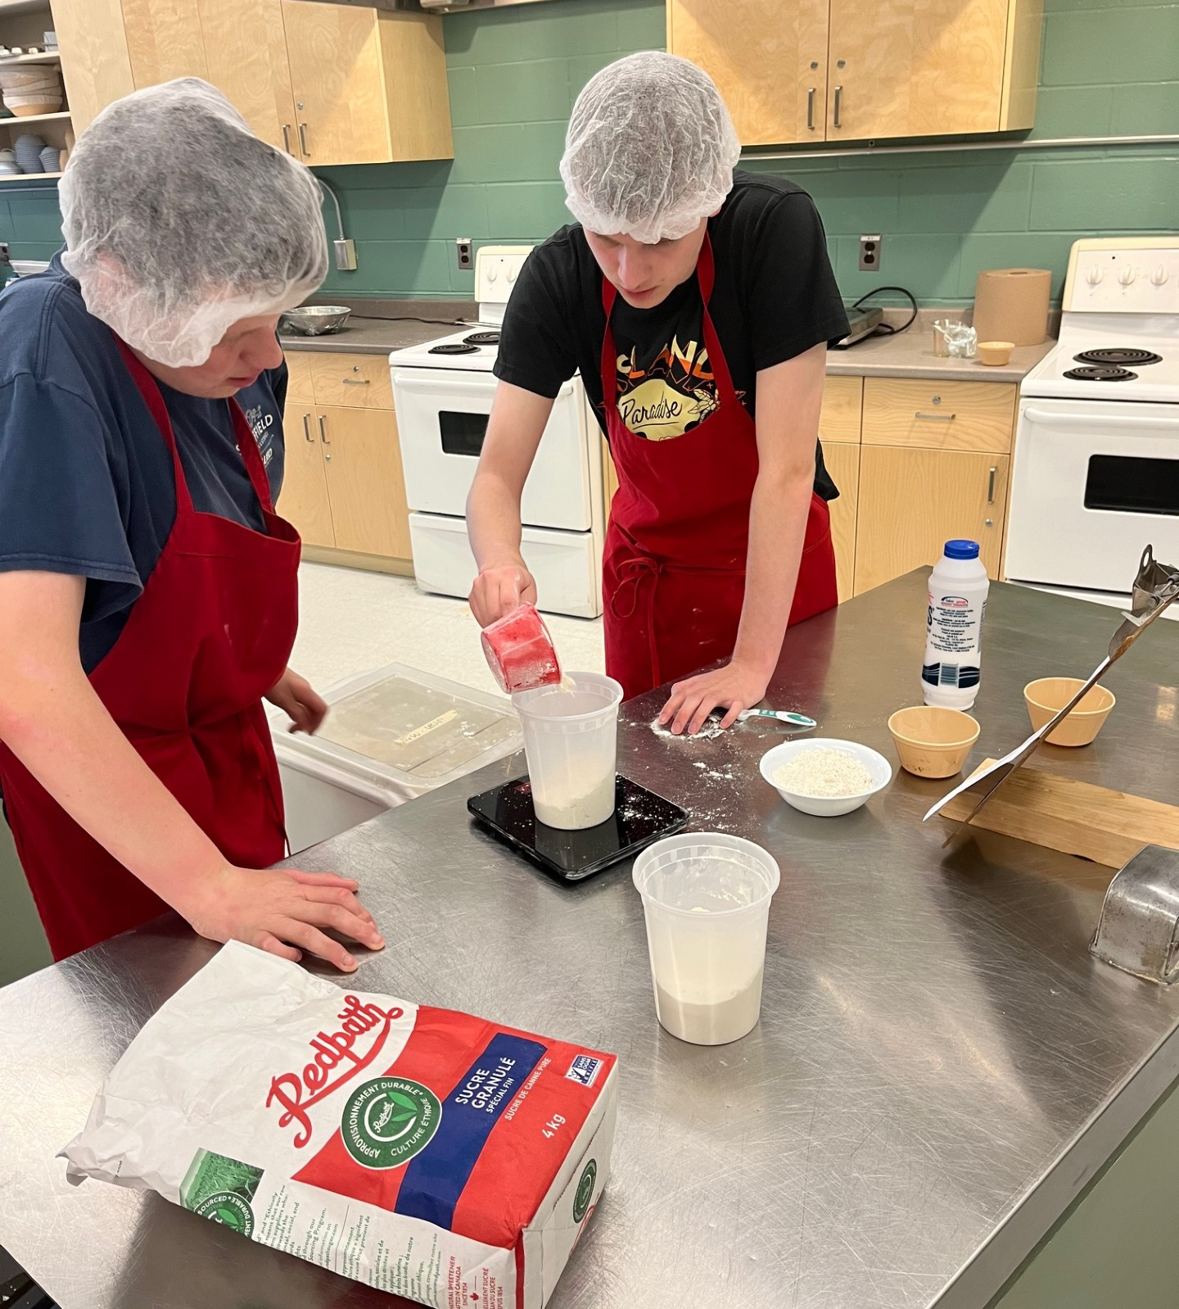
LET’S GET OUR STUDENTS INVOLVED TOO!
There’s lots students can do to help!
Prep food (baking, chopping, assembling)
Coordinate volunteers and schedules
Take inventory of food deliveries
Promote program and recruit peer volunteers
Assist with menu planning
Clean up and maintain the food area
Support with food ordering
Involving students in the School Breakfast Program supports daily operations while helping them build life skills, support peers, and feel a stronger sense of belonging.
Click here for more ideas
An Ottawa where all students thrive.
Une ville d’Ottawa où tous les élèves s’épanouissent.

Slide 10

THANK YOU!
An Ottawa where all students thrive.
Une ville d’Ottawa où tous les élèves s’épanouissent.

